Slide 1










Systematic Review Meta-analysis on EBTC Tox21 Project
ALY 6980 Capstone
Director: Katya Tsaioun, PhD. Johns Hopkins Bloomberg School of Public Health
Instructor: Caroline Moore-Kochlacs, PhD. Northeastern University
Group 1: Kai-Nan Liao, Le Ding, Shuhang Li, Tian Yue, Yifan Wang, Yu-Sheng Chang
Date: June 26th, 2019

Slide 2
Table of Contents
EBTC Tox21 Project Introduction
Project Objectives
Data Specification & Processing
Data Visualization Part 1 (Bubble & Scatter Plots)
Data Visualization Part 2(Box & Forest Plots)
Interpretation & Recommendation
Reference

Slide 3
EBTC Tox21 Project Introduction
EBTC Tox21 is reviewing the existing literature about the impact of drugs on the liver based on in vivo studies on animals and humans.
Systematic literature review of animal and human published studies.
Project Deliverables: Visualization Plots (R Shiny, Plotly), Code (RStudio, Python), Data documentation, Project documentation, Presentation.
Notes:
An especially important goal is to determine the accuracy and validity of current methods for testing chemical safety methods, and assess new tests which are coming into use. This allows alignment between scientific advances, the methods used by scientists in research and industry laboratories and the data requirements of regulatory agencies across worldwide.

Slide 4

Visualization of systematic review
Explore the pattern of liver toxicity of Troglitazone under different conditions(compared with Rosiglitazone)
Provide some recommendations about the future researches
Project Objectives

Slide 5
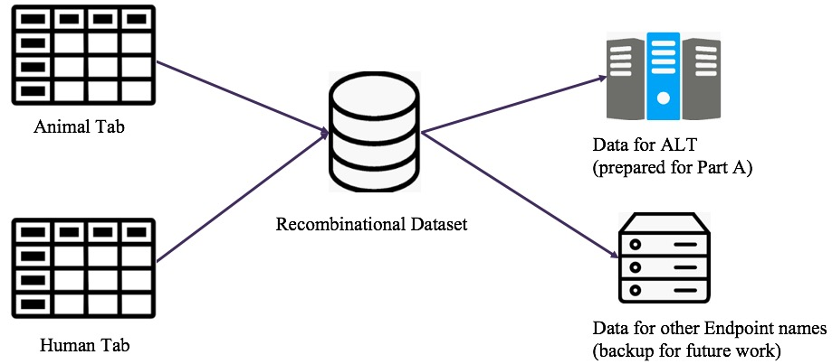
Data Specification & Processing (Part A)

Slide 6
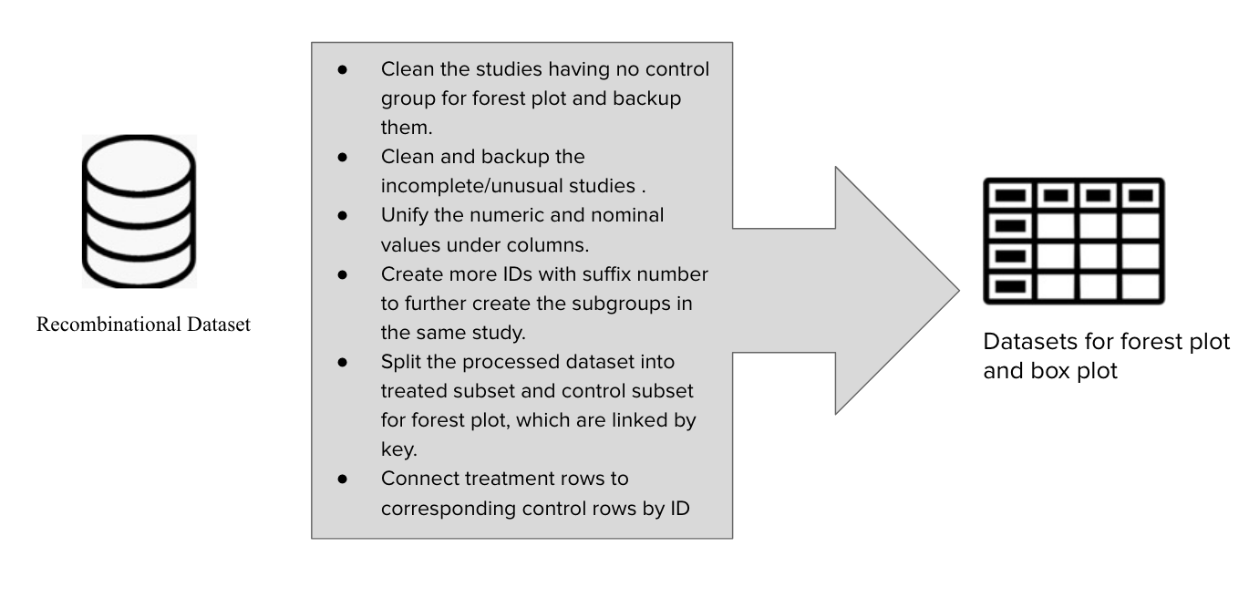
Data Specification & Processing (Part B)
CombinedID: specify different combinations of control and treatment in the same study
ComparedID: specify different treatment groups for the same control group
StudyID: specify different species in
the same study.

Slide 7
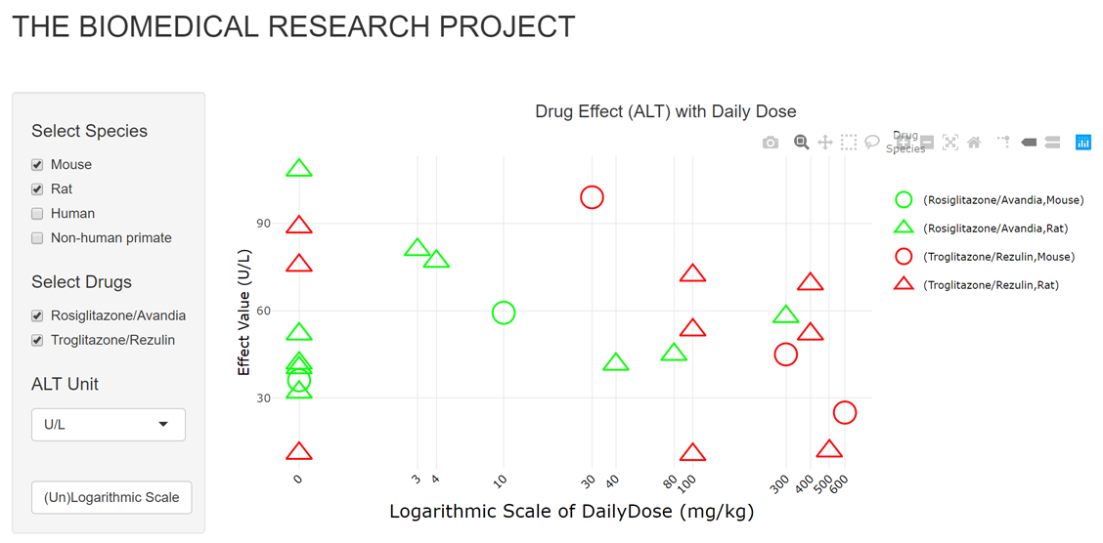
Scatter Plot
No significant effect in both drugs

Slide 8
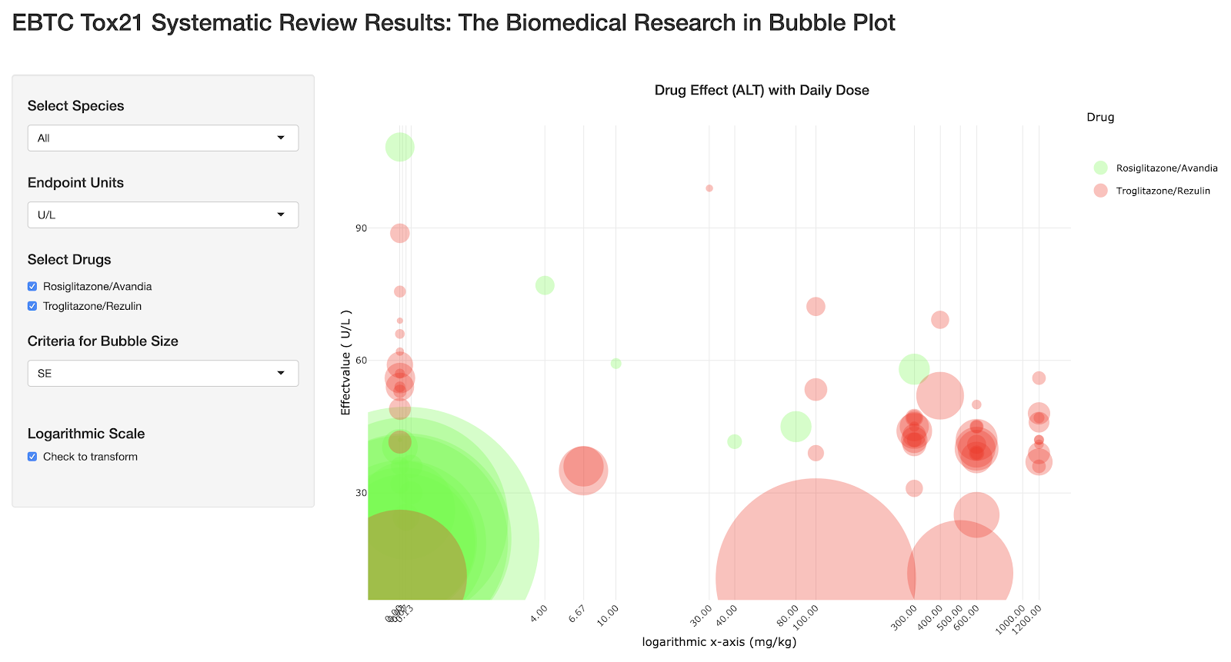
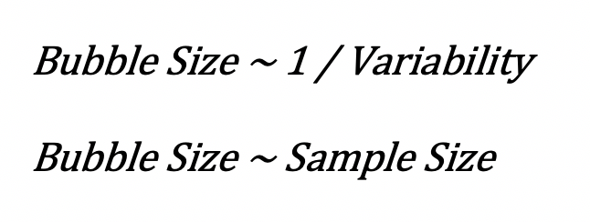
Bubble Plot
High reliability range of the data:
Rosiglitazone 0~0.07;
Troglitazone 100~600.

Slide 9
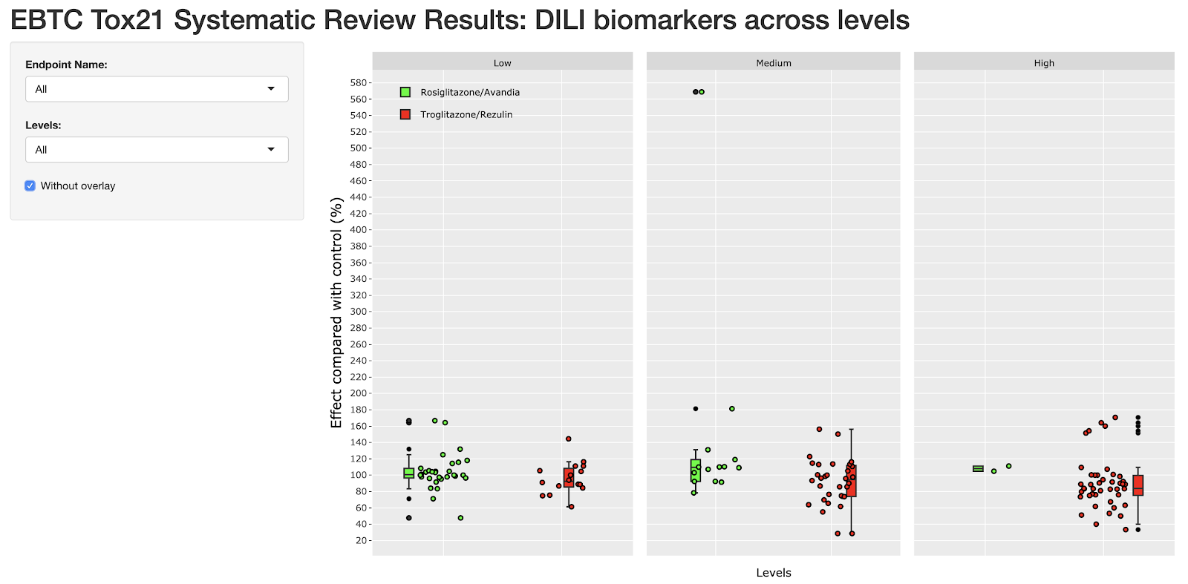
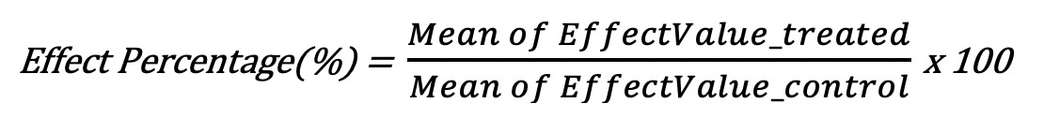
Box Plots by Levels
No significant difference when levels increase

Slide 10
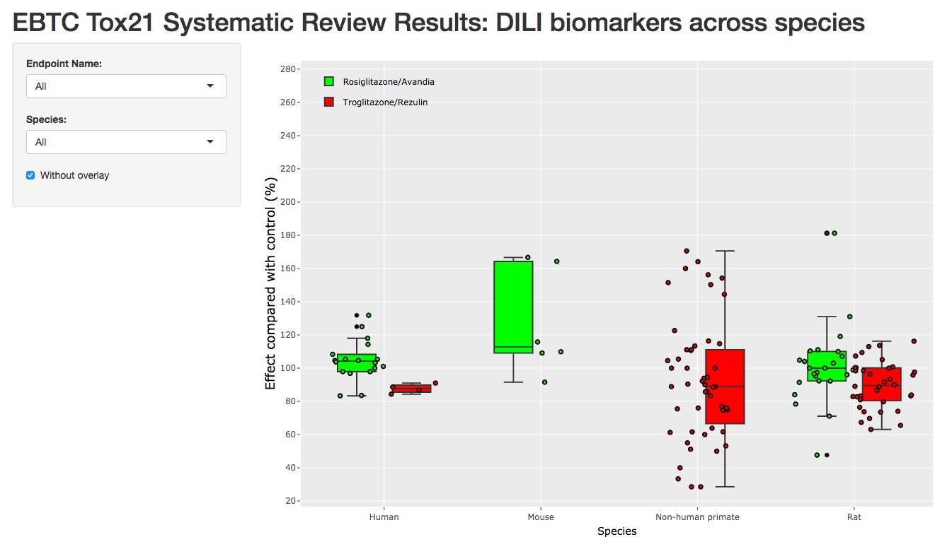
Box Plots by Species
The collected dataset for “mouse” lacks the experimental data of Troglitazone
The collected dataset for “non-human primate” lacks the experimental data of Rosiglitazone

Slide 11
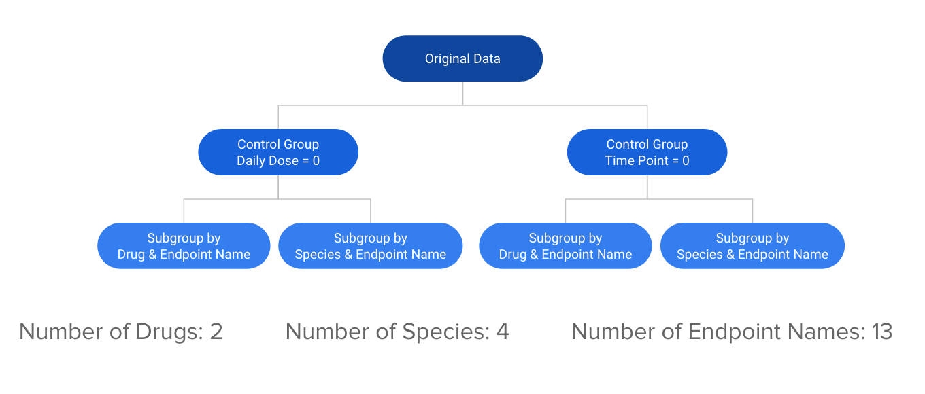
Forest Plot

Slide 12
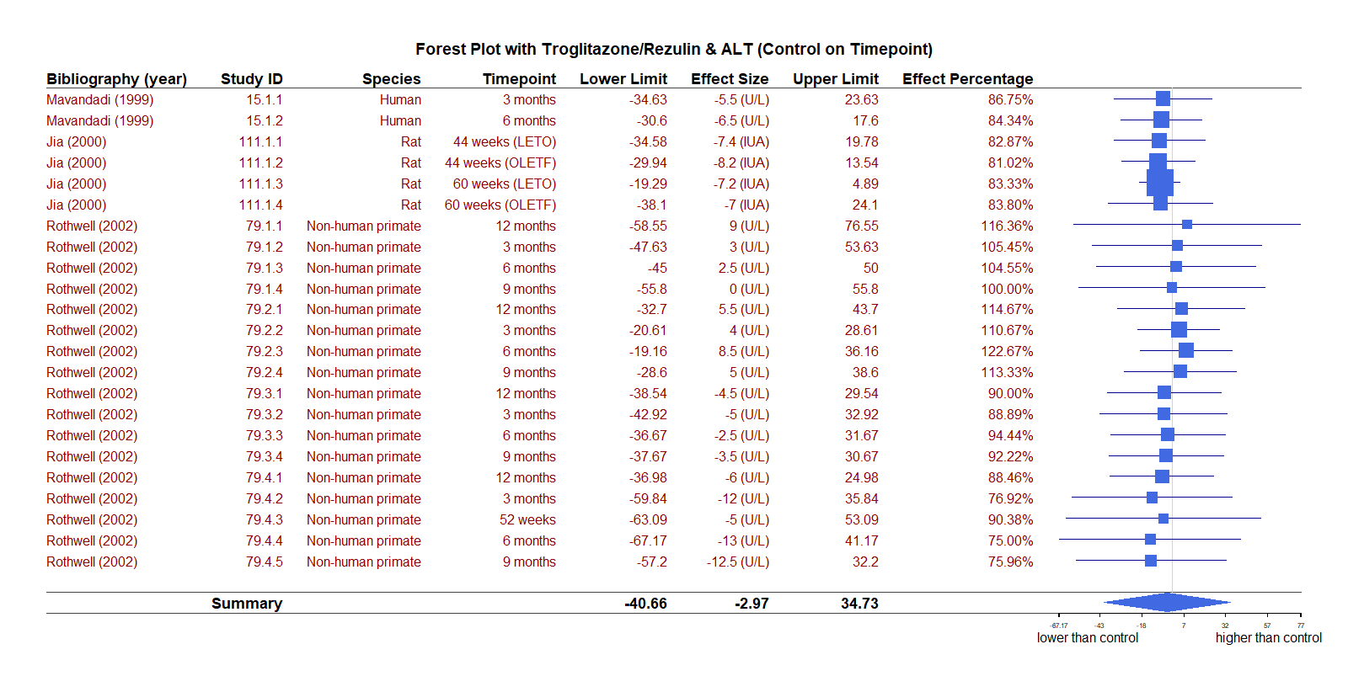
Forest Plot
Effect on ALT of Drug T among Different Species with Control Group on Time Point

Slide 13
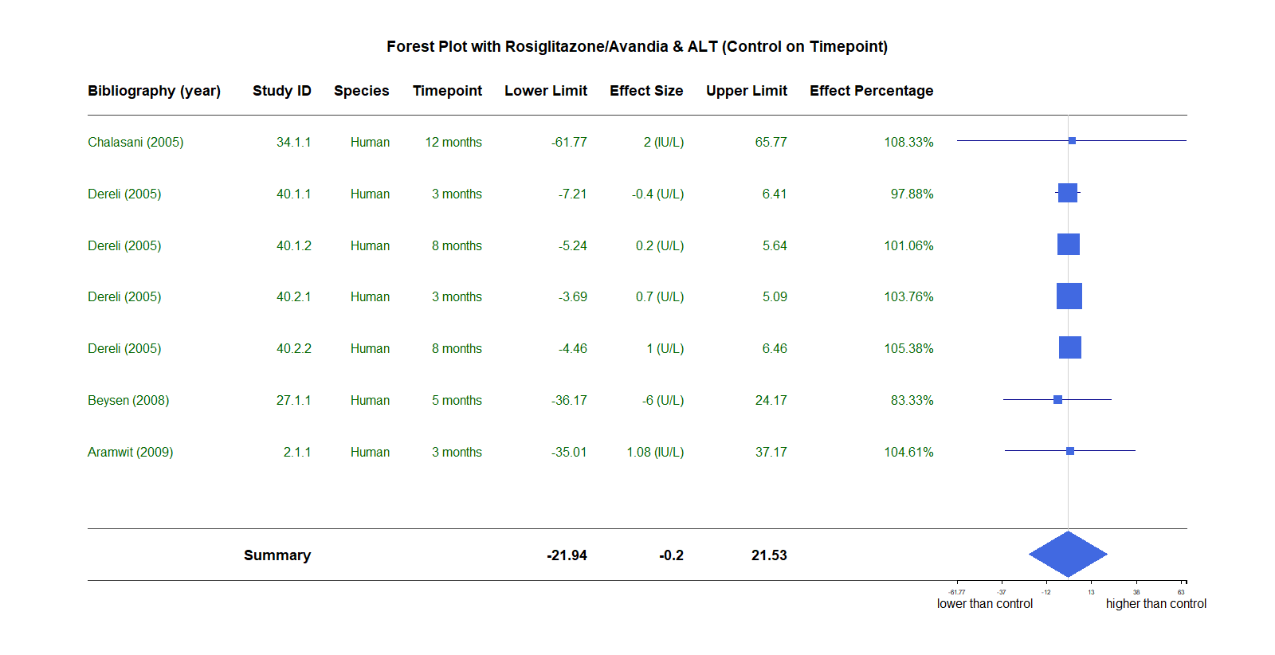
Forest Plot

Slide 14
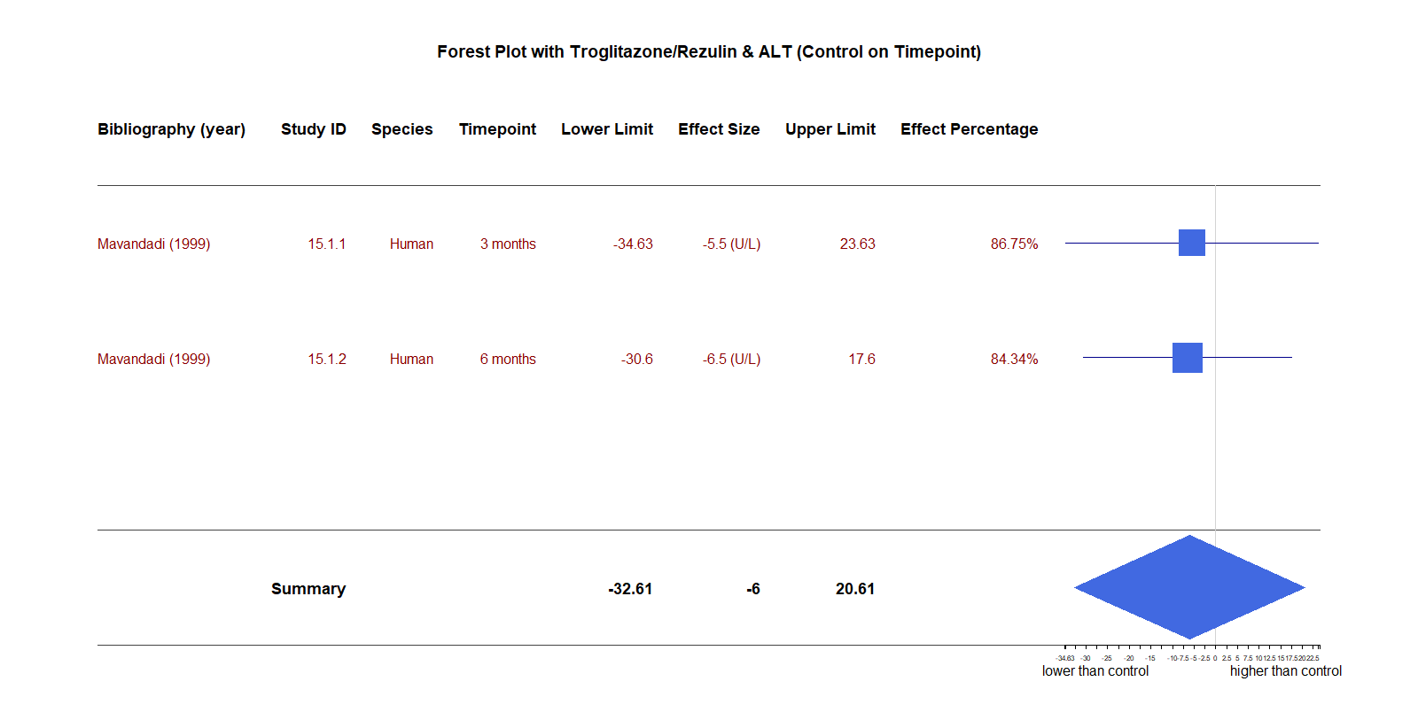
Forest Plot

Slide 15
For scatter plot and bubble plot:
Except for the experimental data based on ALT, other endpoint names’ results should be visualized and observed too. Sole ALT observation can not accurately reflect the pattern of the effect value with rising daily dose.
For the box plot grouped by species:
In order to observe the side effects for different species, it is better to collect more experimental data using Rosiglitazone/Avandia drug on non-human primate, and more data using Troglitazone/Rezulin drug on mouse.
For the boxplot grouped by levels:
It is better to collect more experimental data for high level cumulative Rosiglitazone/Avandia dosage.
For the forest plot:
During the data visualization process, we found that records for different species are insufficient, which might increase the difficulty for comparison. Therefore for each drug category, we recommend recording more integrated experimental data.
Interpretation & Recommendation

Slide 16

Reference
“Alanine Aminotransferase (ALT/SGPT”). (2019). Unitslab. Retrieved from:
http://unitslab.com/node/30
Nair, A. B., & Jacob, S. (2016). A simple practice guide for dose conversion between animals and human. Journal of basic and clinical pharmacy, 7(2), 27.

Slide 17
Special thanks to Dr. Cathalijin Leenaars from Hannover Medical School for the great help throughout the project.

Slide 18
Thank You
Systematic Review Meta-analysis on EBTC Tox21 Project

